Slide 1

Aerobic and anaerobic respiration

Slide 2
Respiration
Living organisms use energy released by respiration for their life processes.
There are two types of respiration – aerobic (which needs oxygen) and anaerobic (which doesn’t need oxygen).

Slide 3
Cellular respiration
Respiration involves chemical reactions that break down nutrient molecules in living cells to release energy.

Slide 4

Energy needs
Energy is needed for the following life processes:
  growth
  cell division
  muscle contraction
  protein synthesis
  active transport
  nerve impulses
  and in humans to maintain body temperature

Slide 5
Types of Respiration
There are two types of respiration – aerobic (which needs oxygen) and anaerobic (which doesn’t need oxygen).

Slide 6
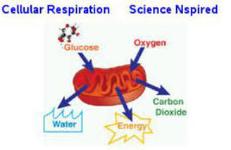
Aerobic respiration
Aerobic respiration needs oxygen.
It is the release of a relatively large amount of energy in cells by the breakdown of food substances in the presence of oxygen:
glucose + oxygen → carbon dioxide + water
C₆H₁₂O₆ + 6O₂ → 6CO₂ + 6H₂O

Slide 7

Aerobic respiration
Aerobic respiration happens all the time in animals and plants.
Note that respiration is different to breathing (ventilation).
Most of the reactions in aerobic respiration happen inside mitochondria in cells.

Slide 8
Anaerobic respiration
Unlike aerobic respiration, anaerobic respiration does not need oxygen.
It is the release of a relatively small amount of energy in cells by the breakdown of food substances in the absence of oxygen.

Slide 9
Anaerobic respiration in muscles
Anaerobic respiration happens in muscles during hard exercise:
glucose → lactic acid
C₆H₁₂O₆ → 2C₃H₆O₃
Glucose is not completely broken down, so much less energy is released than during aerobic respiration

Slide 10
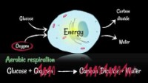

Slide 11
Oxygen debt
The build-up of lactic acid in the muscles anaerobic respiration needs to be removed.
Lactic acid needs to be oxygen to be converted carbon dioxide and water later.
This causes an oxygen debt that needs to be ‘repaid’ after the exercise stops. This is why we keep on breathing deeply for a few minutes after we have finished exercising.

Slide 12
Aerobic respiration vs anaerobic respiration
 | Aerobic | Anerobic
Oxygen | Needed | Not needed
Glucose breakdown | Complete | Incomplete
End product(s) | Carbon dioxide and water | Lactic acid
Energy released | Relatively large amount | Relatively small amount
Aerobic respiration releases 19 times more energy than anaerobic respiration from the same amount of glucose.

Slide 13
Aerobic exercise
Aerobic exercise is sometimes known as "cardio" – exercise that requires pumping of oxygenated blood by the heart to deliver oxygen to working muscles.
Aerobic exercise stimulates the heart rate and breathing rate to increase in a way that can be sustained for the exercise session.

Slide 14

Anaerobic exercise
In contrast, anaerobic ("without oxygen") exercise is activity that causes you to be quickly out of breath, like sprinting or lifting a heavy weight
You cannot sustain this type of activity for extended periods of time
High intensity but short duration

Slide 15
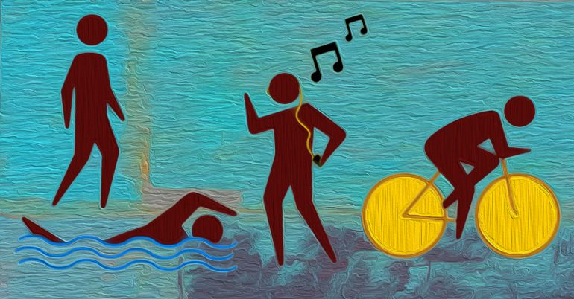
Aerobic exercises
Examples of aerobic exercises include
  spinning,
  running,
  swimming,
  walking,
  hiking,
  aerobics classes,
  dancing,
  cross country, and
  kickboxing.

Slide 16
Aerobic exercise
Aerobic exercises can become anaerobic exercises if performed at a level of intensity that is too high.
Aerobic exercise not only improves fitness; it also has known benefits for both physical and emotional health.

Slide 17
Exercise
Page 50

Slide 18

Benefits of regular aerobic exercise
Heart gets stronger
Heart pumps more blood with each beat (stroke volume)
Greater heart efficiency
Muscles get more efficient at consuming oxygen.
Mitochondria in muscle cells increase in number and efficiency.

